Slide 1
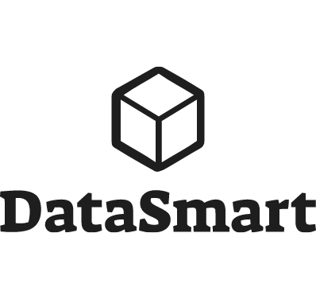


Objectives and what I will cover
My experience of building reporting solutions using Power BI, Power Automate, SharePoint, Office365 and Teams
Technologies covered (demo)
Power BI – Mainly Query
Power Automate
SharePoint
Office 365
Teams
www.DataSmart.ie
Reboot your Data Analytics Strategy with the Power Platform and Microsoft365
@MarkDataGuy
../in/markhayes/
He/him

Slide 2
Power BI / Data Projects 101
4 Key Aspects
Getting Data -> Power Query / M / Get Data
Modelling Data -> Power BI Desktop
Visualizing Data -> Desktop / PowerBI.com
Sharing Data – www.powerbi.com
Lots of data Projects fall into this mode.
Some “go direct” to data.

Slide 3
Demo – Business Requirements
Combine Budget, Company Sales & Retail Sales
3 sources of data
Reports for User
Company Sales – Sourced from ERP
Retail Sales – Excel files that are sent from 2 different data aggregators via email. NB – Does not use corporate product codes
Budget Data – Calculated and stored in Excel

Slide 4

Phase I – Model with Power BI
Power Query / M = Get and Combine Data
Model – Tables and Relationships
Visualize – Create reports
Share – PowerBI.com
Demo
Single Power BI solution
Effective, but stand alone
Requires some additional data maintenance

Slide 5



Phase II – Redesign and start leveraging Office
Power BI – Extract / Model / Visualize
Data Flows – Share Data
Excel – Adhoc
SharePoint/Teams – Maintain Data & Visualize
Demo
Single Data sources for multiple models
SharePoint Online Data Maintenance
SharePoint Dashboard
Pivot Tables

Slide 6

Phase III – Automate
Automate & Orchestrate
Work Flow
And lots of cool useful stuff
Demo
Automate File Load and Refresh
Some fun with Sentiment

Slide 7
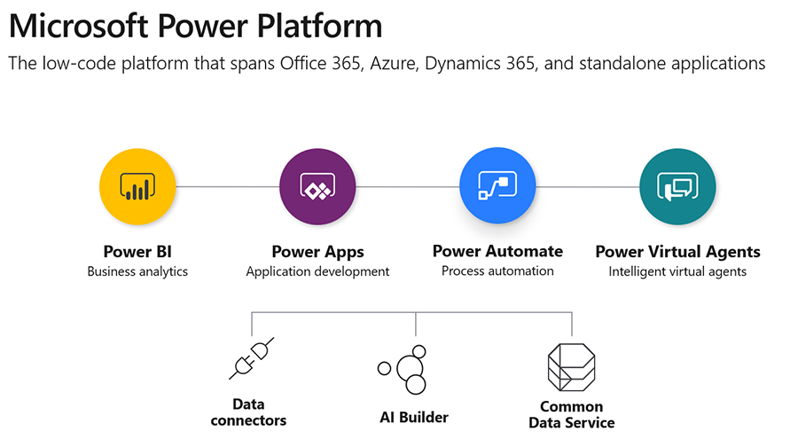
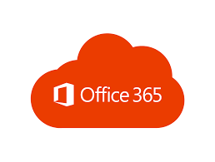

Phase IV – Power Platform

Slide 8
Conclusions….
Lots of reporting and analytical needs can be addressed
You don’t have to be “IT” to do a lot, but data projects can be complex. (Modelling/M2M/Distinct/DAX/M)
You may already own some of this stuff. Power BI + Office 365 = Model, Pivot Table, SharePoint, Portal, Teams, Automate..
SaaS Cost. (it can get expensive, or be amazingly cost effective)

Slide 9
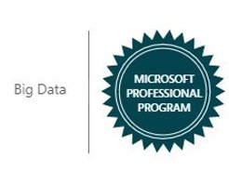

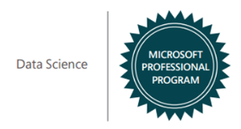
Reboot your SME Data Analytics Strategy
Mark Hayes
@MarkDataGuy
../in/markhayes/
www.DataSmart.ie

